Slide 1
Network-Attached Storage
A network-attached storage (NAS) device is a dedicated storage system that can be accessed via the data network.
Clients access NAS through a remote procedure call interface, like a CIFS for Windows computers or a network file system for Unix.
Remote procedure calls (RPCs) are transmitted through TCP or UDP via an IP network, which is often the same LAN that delivers all data traffic to the clients.
Generally, the network-attached storage unit is constructed as a RAID array with software that supports the RPC interface.
It is easy to consider NAS as just another storage-access protocol. For example, a NAS system may access storage through RPC via TCP/IP rather than a SCSI device driver and SCSI protocols.

Slide 2
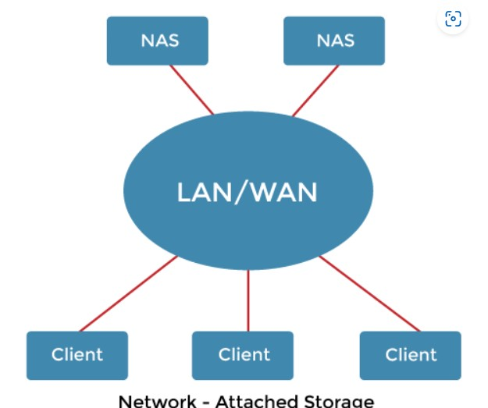


Slide 3
NAS allows all systems on a local area network to share a pool of storage with the same simplicity of naming and access as local host-attached storage provides.
However, it is less efficient and performs worse than other direct-attached storage solutions.
ISCSI (Internet Small Computer Systems Interface) is the latest network-attached storage protocol.
The SCSI protocol is carried across the IP network protocol.
As a result, the SCSI protocol uses the networks to interconnect hosts and their storage than SCSI cables.

Slide 4
Storage-Area Network
The one downside of network-attached storage systems is bandwidth usage on the data network by storage I/O activities, which increases network latency.
This problem is most acute in large client-server configurations because server-to-client communications compete for bandwidth with server-to-storage communications.

Slide 5
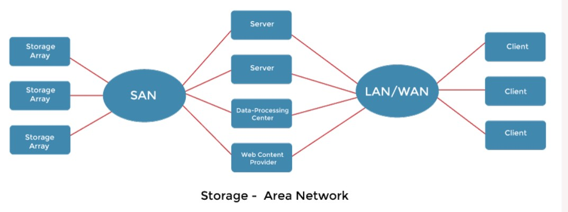

Slide 6
SAN is a private network that uses storage protocols to connect servers and storage devices instead of networking standards. T
he flexibility of a SAN is its strength. Multiple hosts and storage arrays may connect to the same SAN, and storage may be allocated dynamically to hosts.
A SAN switch permits or prohibits access between hosts and storage. For example, if a host's disk space is running short, the SAN may be set to allocate more storage to that server.
SANs enable server clusters to share the same storage and storage arrays to contain several direct host connections.

Slide 7
SANs often have more ports at a lower cost than storage arrays. The most common is FC.
InfiniBand is a new option for high-speed connectivity networks for servers and storage units.
It is a special-purpose bus architecture that provides hardware and software support for servers and storage units high-speed connectivity networks.

Slide 8
Disk Scheduling
As we know, a process needs two type of time, CPU time and IO time. For I/O, it requests the Operating system to access the disk.
However, the operating system must be fare enough to satisfy each request and at the same time, operating system must maintain the efficiency and speed of process execution.
The technique that operating system uses to determine the request which is to be satisfied next is called disk scheduling.
Let's discuss some important terms related to disk scheduling.

Slide 9
Seek Time
Seek time is the time taken in locating the disk arm to a specified track where the read/write request will be satisfied.
Rotational Latency
It is the time taken by the desired sector to rotate itself to the position from where it can access the R/W heads.
Transfer Time
It is the time taken to transfer the data.
Disk Access Time
Disk access time is given as,
Disk Access Time = Rotational Latency + Seek Time + Transfer Time

Slide 10
Disk Response Time
It is the average of time spent by each request waiting for the IO operation.
Purpose of Disk Scheduling
The main purpose of disk scheduling algorithm is to select a disk request from the queue of IO requests and decide the schedule when this request will be processed.

Slide 11
Disk Scheduling Algorithms
The list of various disks scheduling algorithm is given below. Each algorithm is carrying some advantages and disadvantages.
The limitation of each algorithm leads to the evolution of a new algorithm.
FCFS scheduling algorithm
SSTF (shortest seek time first) algorithm
SCAN scheduling
C-SCAN scheduling
LOOK Scheduling
C-LOOK scheduling

Slide 12
FCFS Scheduling Algorithm
It is the simplest Disk Scheduling algorithm. It services the IO requests in the order in which they arrive. There is no starvation in this algorithm, every request is serviced.
Advantages:
Every request gets a fair chance
No indefinite postponement
Disadvantages:
Does not try to optimize seek time
May not provide the best possible service

Slide 13
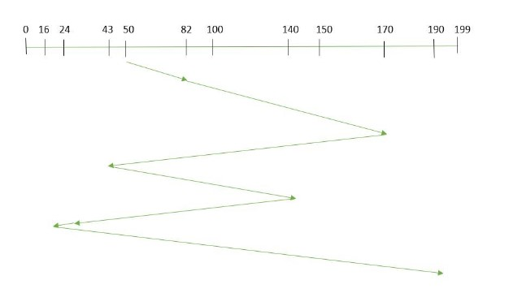
Example:
Total number of tracks are 200. Suppose the order of request is- (82,170,43,140,24,16,190) And current position of Read/Write head is : 50

Slide 14
total seek time:
=(82-50)+(170-82)+(170-43)+(140-43)+(140-24)+(24-16)+(190-16) =642

Slide 15
Example
Consider the following disk request sequence for a disk with 100 tracks 45, 21, 67, 90, 4, 50, 89, 52, 61, 87, 25 .
Head pointer starting at 50 and moving in left direction. Find the number of head movements in cylinders using FCFS scheduling.
Solution:

Slide 16
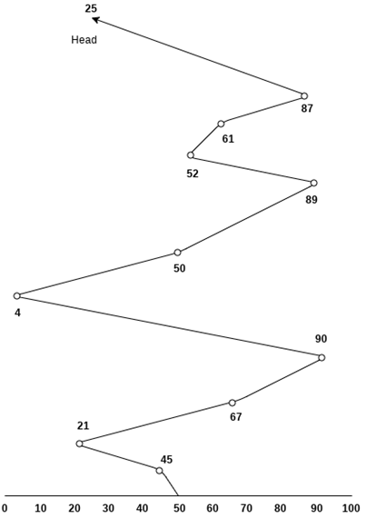

Slide 17
Number of cylinders moved by the head
=(50-45)+(45-21)+(67-21)+(90-67)+(90-4)+(50-4)+(89-50)+(61-52)+(87-61)+(87-25)
= 5 + 24 + 46 + 23 + 86 + 46 + 49 + 9 + 26 + 62
= 376

Slide 18
SSTF Scheduling Algorithm
Shortest seek time first (SSTF) algorithm selects the disk I/O request which requires the least disk arm movement from its current position regardless of the direction. It reduces the total seek time as compared to FCFS.
It allows the head to move to the closest track in the service queue.

Slide 19
Advantages:
Average Response Time decreases
Throughput increases
Disadvantages
It may cause starvation for some requests.
Switching direction on the frequent basis slows the working of algorithm.
It is not the most optimal algorithm.

Slide 20
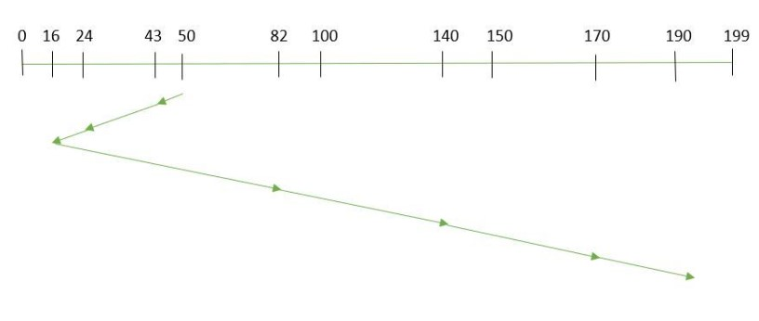
Example:
Suppose the order of request is- (82,170,43,140,24,16,190) And current position of Read/Write head is : 50
total seek time:
=(50-43)+(43-24)+(24-16)+(82-16)+(140-82)+(170-140)+(190-170) =208

Slide 21
Example
Consider the following disk request sequence for a disk with 100 tracks
45, 21, 67, 90, 4, 89, 52, 61, 87, 25
Head pointer starting at 50. Find the number of head movements in cylinders using SSTF scheduling.

Slide 22
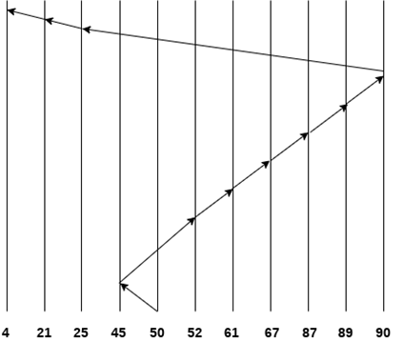
Number of cylinders = 5 + 7 + 9 + 6 + 20 + 2 + 1 + 65 + 4 + 17 = 136

Slide 23
SCAN
In SCAN algorithm the disk arm moves into a particular direction and services the requests coming in its path and after reaching the end of disk, it reverses its direction and again services the request arriving in its path.
So, this algorithm works as an elevator and hence also known as elevator algorithm.
As a result, the requests at the midrange are serviced more and those arriving behind the disk arm will have to wait.

Slide 24
Advantages:
High throughput
Low variance of response time
Average response time
Disadvantages:
Long waiting time for requests for locations just visited by disk arm

Slide 25
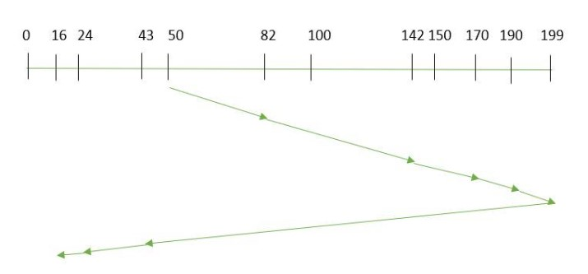
Example:
Suppose the requests to be addressed are-82,170,43,140,24,16,190. And the Read/Write arm is at 50, and it is also given that the disk arm should move “towards the larger value”.
the seek time is calculated as: =(199-50)+(199-16) =332

Slide 26
CSCAN
In SCAN algorithm, the disk arm again scans the path that has been scanned, after reversing its direction. So, it may be possible that too many requests are waiting at the other end or there may be zero or few requests pending at the scanned area.
These situations are avoided in CSCAN algorithm in which the disk arm instead of reversing its direction goes to the other end of the disk and starts servicing the requests from there. So, the disk arm moves in a circular fashion and this algorithm is also similar to SCAN algorithm and hence it is known as C-SCAN (Circular SCAN).
Advantages:
Provides more uniform wait time compared to SCAN

Slide 27
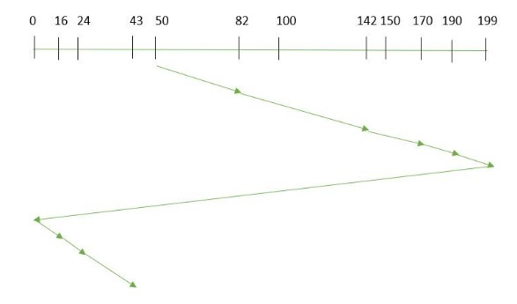
Example:
Suppose the requests to be addressed are-82,170,43,140,24,16,190. And the Read/Write arm is at 50, and it is also given that the disk arm should move “towards the larger value”.
Seek time is calculated as:
=(199-50)+(199-0)+(43-0) =391

Slide 28
LOOK
It is similar to the SCAN disk scheduling algorithm except for the difference that the disk arm in spite of going to the end of the disk goes only to the last request to be serviced in front of the head and then reverses its direction from there only.
Thus it prevents the extra delay which occurred due to unnecessary traversal to the end of the disk.

Slide 29
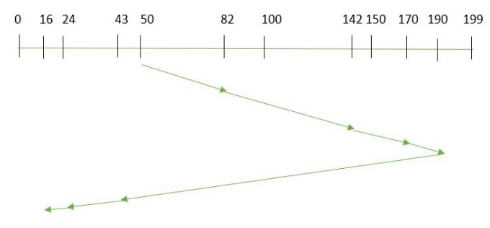
Example:
Suppose the requests to be addressed are-82,170,43,140,24,16,190. And the Read/Write arm is at 50, and it is also given that the disk arm should move “towards the larger value”.
the seek time is calculated as:
=(190-50)+(190-16) =314

Slide 30
CLOOK
As LOOK is similar to SCAN algorithm, in similar way, CLOOK is similar to CSCAN disk scheduling algorithm. In CLOOK, the disk arm in spite of going to the end goes only to the last request to be serviced in front of the head and then from there goes to the other end’s last request. Thus, it also prevents the extra delay which occurred due to unnecessary traversal to the end of the disk.

Slide 31
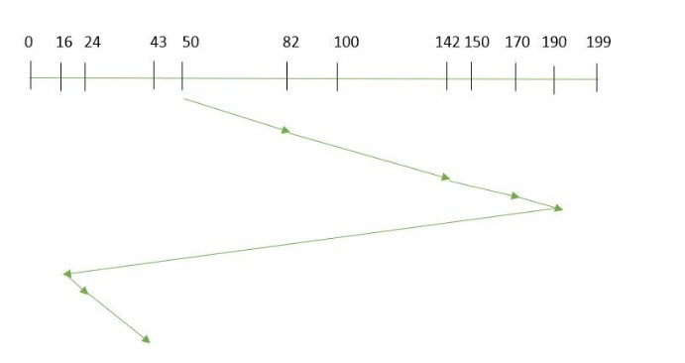
Example:
Suppose the requests to be addressed are-82,170,43,140,24,16,190. And the Read/Write arm is at 50, and it is also given that the disk arm should move “towards the larger value”
the seek time is calculated as:
= (190-50)+(190-16)+(43-16) = 341

Slide 32
Disk management
Disk management of the operating system includes:
Disk Format
Booting from disk
Bad block recovery

Slide 33
Disk Formatting
A new magnetic disk is mainly a blank slate. It is platters of the magnetic recording material.
Before a disk may hold data, it must be partitioned into sectors that may be read and written by the disk controller.
It is known as physical formatting and low-level formatting.
Low-level formatting creates a unique data structure for every sector on the drive.
A data structure for a sector is made up of a header, a data region, and a trailer.
The disk controller uses the header and trailer to store information like an error-correcting code (ECC) and a sector number.

Slide 34
The OS must require recording its own data structures on the disk drive to utilize it as a storage medium for files.
It accomplishes this in two phases. The initial step is to divide the disk drive into one or more cylinder groups.
The OS may treat every partition as it were a separate disk.
For example, one partition could contain a copy of the OS executable code, while another could contain user files.
The second stage after partitioning is logical formatting.
The operating store stores the initial file system data structure on the disk drive in this second stage.

Slide 35
Boot block:
When a system is turned on or restarted, it must execute an initial program. The start program of the system is called the bootstrap program.
It starts the OS after initializing all components of the system.
The bootstrap program works by looking for the OS kernel on disk, loading it into memory, and jumping to an initial address to start the OS execution.
The bootstrap is usually kept in read-only memory on most computer systems.
It is useful since read-only memory does not require initialization and is at a fixed location where the CPU may begin executing whether powered on or reset.
Furthermore, it may not be affected by a computer system virus because ROM is read-only.
The issue is that updating this bootstrap code needs replacing the ROM hardware chips.

Slide 36
As a result, most computer systems include small bootstrap loader software in the boot ROM, whose primary function is to load a full bootstrap program from a disk drive.
The entire bootstrap program can be modified easily, and the disk is rewritten with a fresh version.
The bootstrap program is stored in a partition and is referred to as the boot block.
A boot disk or system disk is a type of disk that contains a boot partition.

Slide 37
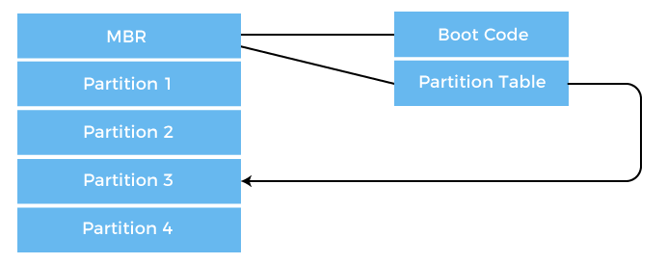
How Boot Block Works?
Let's try to understand this using an example of the boot process in Windows 2000.
The Windows 2000 stores its boot code in the first sector on the hard disk. The following image shows the booting from disk in Windows 2000.

Slide 38
Moreover, Windows 2000 allows the hard disk to be divided into one or more partitions. This one partition is identified as the boot partition, containing the operating system and the device drivers.
In Windows 2000, booting starts by running the code placed in the system's ROM memory.
This code allows the system to read code directly from the Master Boot Record or MBR.
The MBR also contains the table that lists the partition for the hard disk and a flag indicating which partition is to be boot from the system.
Once the system identifies the boot partition, it reads the first sector from memory, known as a boot sector. It continues the process with the remainder of the boot process, which includes loading various system services.

Slide 39
Bad Blocks:
Disks are prone to failure due to their moving parts and tight tolerances.
When a disk drive fails, it must be replaced and the contents transferred to the replacement disk using backup media.
For some time, one or more sectors become faulty.
Most disks also come from the company with bad blocks.
These blocks are handled in various ways, depending on the use of disk and controller.
On the disk, the controller keeps a list of bad blocks.
The list is initialized during the factory's low-level format and updated during the disk's life.
Each bad sector may be replaced with one of the spare sectors by directing the controller.
This process is referred to as sector sparing.

